Slide 1
Ad Hoc Committee Presentation to
Ridgewood Council for Schedler Property
December 2017

Slide 2

Agenda
Background of Schedler property
Schedler Ad Hoc Committee
Process
Clean Up Phase I Details
Park Development Options
Neighborhood Concerns and Remediation Proposals
Q & A

Slide 3
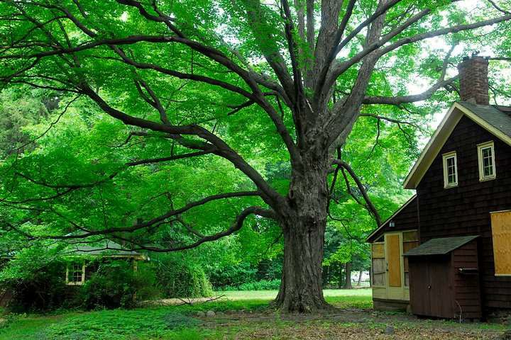
Background of Schedler Property
Zabriskie-Schedler House is one of the last remaining 1820’s Dutch wood frame houses in Bergen County
In 2003, Ridgewood Open Space Committee submitted plan identifying Schedler property as a “first-priority” target for acquisition by Ridgewood
In 2007, Village was informed that family would be selling Schedler property
In 2008, Open Space Committee provided Council with report recommending that “the initial development [of Schedler property] consist of a parking lot, a baseball diamond and overlay multipurpose field (without lights or restrooms), with the remainder of property left as passive recreation space with wooded areas and a disabled-accessible (ADA compliant), senior-friendly paved walking path around the perimeter”

Slide 4
Background of Schedler Property (cont’d)
In 2008, Open Space Committee urged Village to acquire Schedler property, warning that “if the property is acquired by a private developer, the Village will face the possibility of a ‘builder remedy’ suit forcing the Village to accept high-density multi-family residential development of the property including affordable housing units”
In 2009, Village purchased Schedler property for $2.7 million with grants from the Bergen County Open Space Trust Fund
In 2013, Village purchased Shotmeyer property, a .358 acre parcel of land that was surrounded by the Schedler property, for approximately $90,000.
In 2015, Council passed resolution adopting Open Space Committee’s recommendation for passive and active park that included playground, walking path, 90 ft. baseball diamond, and a 120 x 75 yd. multi-purpose field. Resolution also provided road map for stabilization and possible restoration of Schedler house
In 2017, the Council rescinded 2015 resolution, deciding instead to re-analyze the proposed plan for Schedler, and appointed this Ad Hoc Committee to propose a development plan.

Slide 5
Schedler Ad Hoc Committee Formed
Members appointed by Council to reach consensus on future design and use of park on Schedler property
Provide transparency in the process of feature selection for the park to all parties
Appropriate representation of neighborhood and other interested parties on Committee
Goals:
Agree on high level features of the design and present options to Council members by December 2017
Members: Ramon Hache, Michael Sedon, Michael Winograd, Nancy Bigos, Matthew Cunningham, Dan Cramblitt, Tim Cronin, Manish Shrimali, Nick Whitney, Phil Dolce, Paul D’Arpa, Ellie Gruber

Slide 6
Process
Inclusive, collaborative and transparent process
Discussed background, goal of committee, and views and concerns of various groups
Gathered relevant data and facts
-- Reviewed background, interests, reports and surveys
-- Walked property with park development expert
-- Invited input from and met with groups, including sports groups, neighborhood group and others
-- Reviewed expert studies and met with expert/consultant (traffic/safety, noise, environmental)
Assessed needs (and factual basis thereof) for active and passive space
Developed potential proposals balancing needs with resident interests
Engaged Village Engineering Department to draw up potential proposals
Discussed potential proposals with, and solicited input from, groups
Achieved consensus on potential proposal for presentation to Council
Agreed on Clean Up Phase 1 Scope with all parties involved
Communicated details of proposed plan and clean up with groups
Created presentation of proposal for Council

Slide 7
Schedler Clean Up Phase I Details
Removal of garage, shed and capping of the well
Removal of dead and diseased trees, unwanted shrubs
Fixed price contract coming out of grant money and needed to be and was contracted by end of October
Outside Arborist marked trees to be removed (complete)
3 days period for everyone to review the marked trees (complete)
Work to be monitored by town Park and Rec officials

Slide 8
Meetings with Sports Groups
Conclusion: There is a significant need for additional multi- purpose field space across all sports
No sport is in danger of collapsing without additional space, but each sport is currently materially limited and operating under sub-optimal conditions due to field limits and field quality
The majority of the participation in Ridgewood sports is pre- high school
Participation in meetings from Ridgewood Lacrosse, Football, Baseball/Softball, Soccer, Hockey

Slide 9
Park Development Options Considered
Multi purpose Field Sizes Reviewed
60x40 yards
75x50 yards
80x60 yards
120x75 yards
Other features considered
Children’s playground
Bathroom with overhang shelter
Parking lot
Walking trails
Berm with tree line across top
Fencing
Trees along street
Placement vis-a-vis house
Pickleball court

Slide 10
Recommendation
Committee recommends building a
field
Field will be multipurpose and will benefit multiple Village sports groups, primarily at the pre-high school age groups with aggregate total of participation of approximately 1,000 Ridgewood youth
Other features
Children’s playground
2 stall ADA compliant Bathroom with overhang shelter
44 spot Parking lot (between house and Rt. 17)
Walking trails
Berm with tree line across top
Fencing
Trees along street
Committee has considered the costs and benefits of multiple field surface options and preliminarily recommends FieldTurf CoolPlay, an artificial grass surface that allows for significantly more use; has no exposed rubber; remains significantly cooler than other artificial grass surfaces; maintains green, manicured appearance; and is economically sensible.

Slide 11
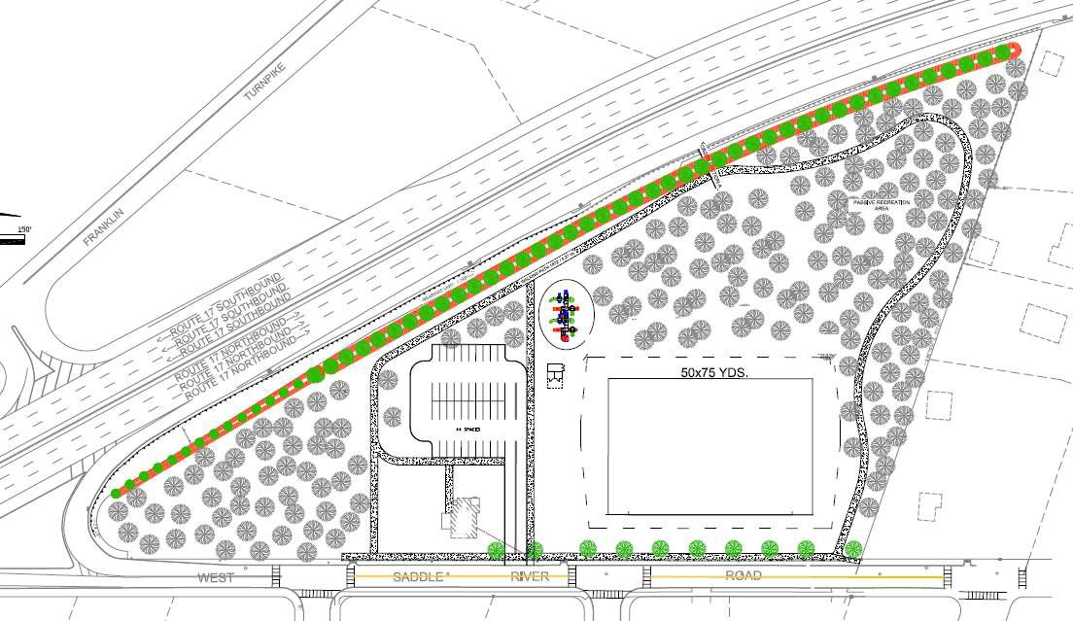
Recommended Option A (75x50)
Not a blueprint

Slide 12
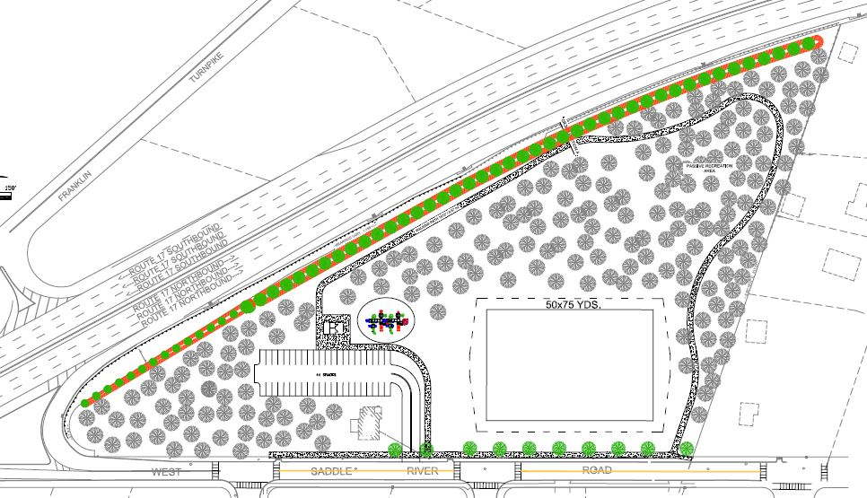
Recommended Option B (75x50)
Not a blueprint

Slide 13
Meetings with Neighbors
Met with neighbors to document all key concerns
Informed them of steps to be taken to address the concerns
Heard their views on options being considered by committee
Explained needs from different sports team and benefits for each option being considered
Clarified their doubts and questions on Clean Up Phase
Gave them opportunity to review property marked by external Arborist for clean up phase.
Sent electronic and door to door communication about clean up phase and options being proposed to council by the ad hoc committee

Slide 14
Concerns and Remediation Proposals
Size of field
75x50 yard field optimizes benefit to sports groups, keeps desired active/passive balance, and addresses concerns of neighborhood
Sound
6 foot, tree lined berm proposed alongside Route 17
Tree line proposed along West Saddle River Road

Slide 15
Concerns and Remediation Proposals (cont‘d)
Preservation of History
Historic plaques along walking paths.
Renaming of park with potential consideration to historical background of property
Historical study of property ongoing
Care given in aesthetic design to placement of various features vis-a-vis location and restoration of house

Slide 16
Concerns and Remediation Proposals (cont'd)
Safety
Entrance of Park is considered only where Terhune Rd and West Saddle River road meet. This allows for maximum slowing time for traffic exiting West Saddle River road exit from Route 17
Collaborate with Ridgewood Police department to monitor the park and the neighborhood to prevent vandalism and criminal activity
Crosswalk for neighborhood kids
Fence along West Saddle River Road
Low level parking safety lights

Slide 17
Concerns and Remediation Proposals (cont'd)
Quality of Life
Prohibition of non-safety lights (both permanent and portable)
Prohibition of public address announcement system
Prohibition of permanent concession stand
Park hours from dawn to dusk

Slide 18
Concerns and Remediation Proposals (cont'd)
Applicable studies conducted by Independent Experts
Traffic/Safety, Noise and Environmental studies have been or are to be performed by professionals contracted by Village of Ridgewood

Slide 19

Q & A

Slide 20
Reference
Schedler property total area: 7.11 acres = 309,712 sq. ft.
75x50 yard field with the five yard boundary and fence along perimeter = 45,900 sq. ft.

